Slide 1
Software development in agile methodology

Slide 2
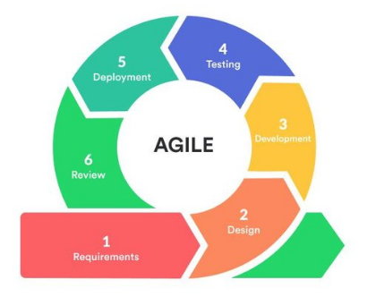
Agile methodology
It is an iterative approach to manage a project by breaking up into several phase.
The goal is to focus more on producing working software and less on documentation.

Slide 3
Teminology
Epic
Roadmap
Backlog
Sprint
Story

Slide 4
Cost estimation:
Critical activity
Risk Management

Slide 5
Advantage:
Good communication
Faster delivery
Customer satistaction
Adoptability
Disadvantages:
Predictability
More time

